Slide 1
The Quicket System: A fast pass to the future of ticketing
Drew Mohundro, Alex Bigej, Preston May, Carol Pollard, Garrett Smith

Slide 2
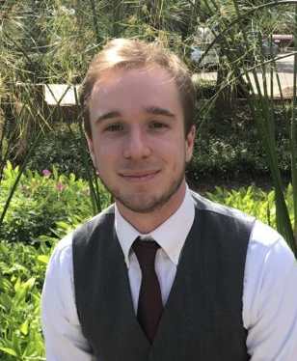
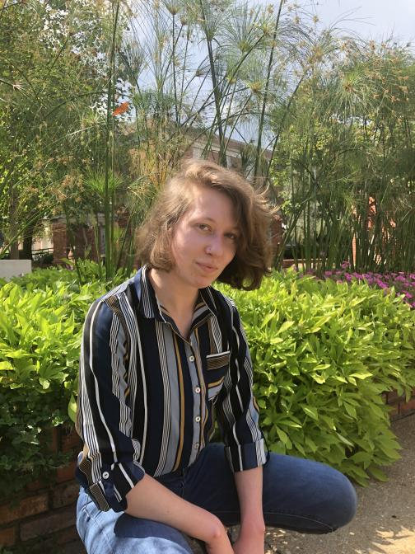
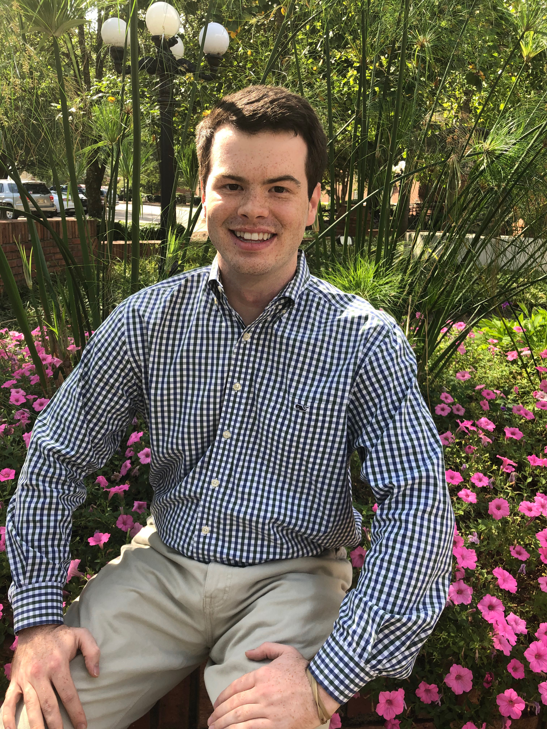
Team Members: Electrical Engineers
Drew Mohundro
Team Lead
Reader and Tag
Subsystem
Alex Bigej
Error Signaling
Subsystem
Preston May
Hardware Interfacing
Subsystem

Slide 3
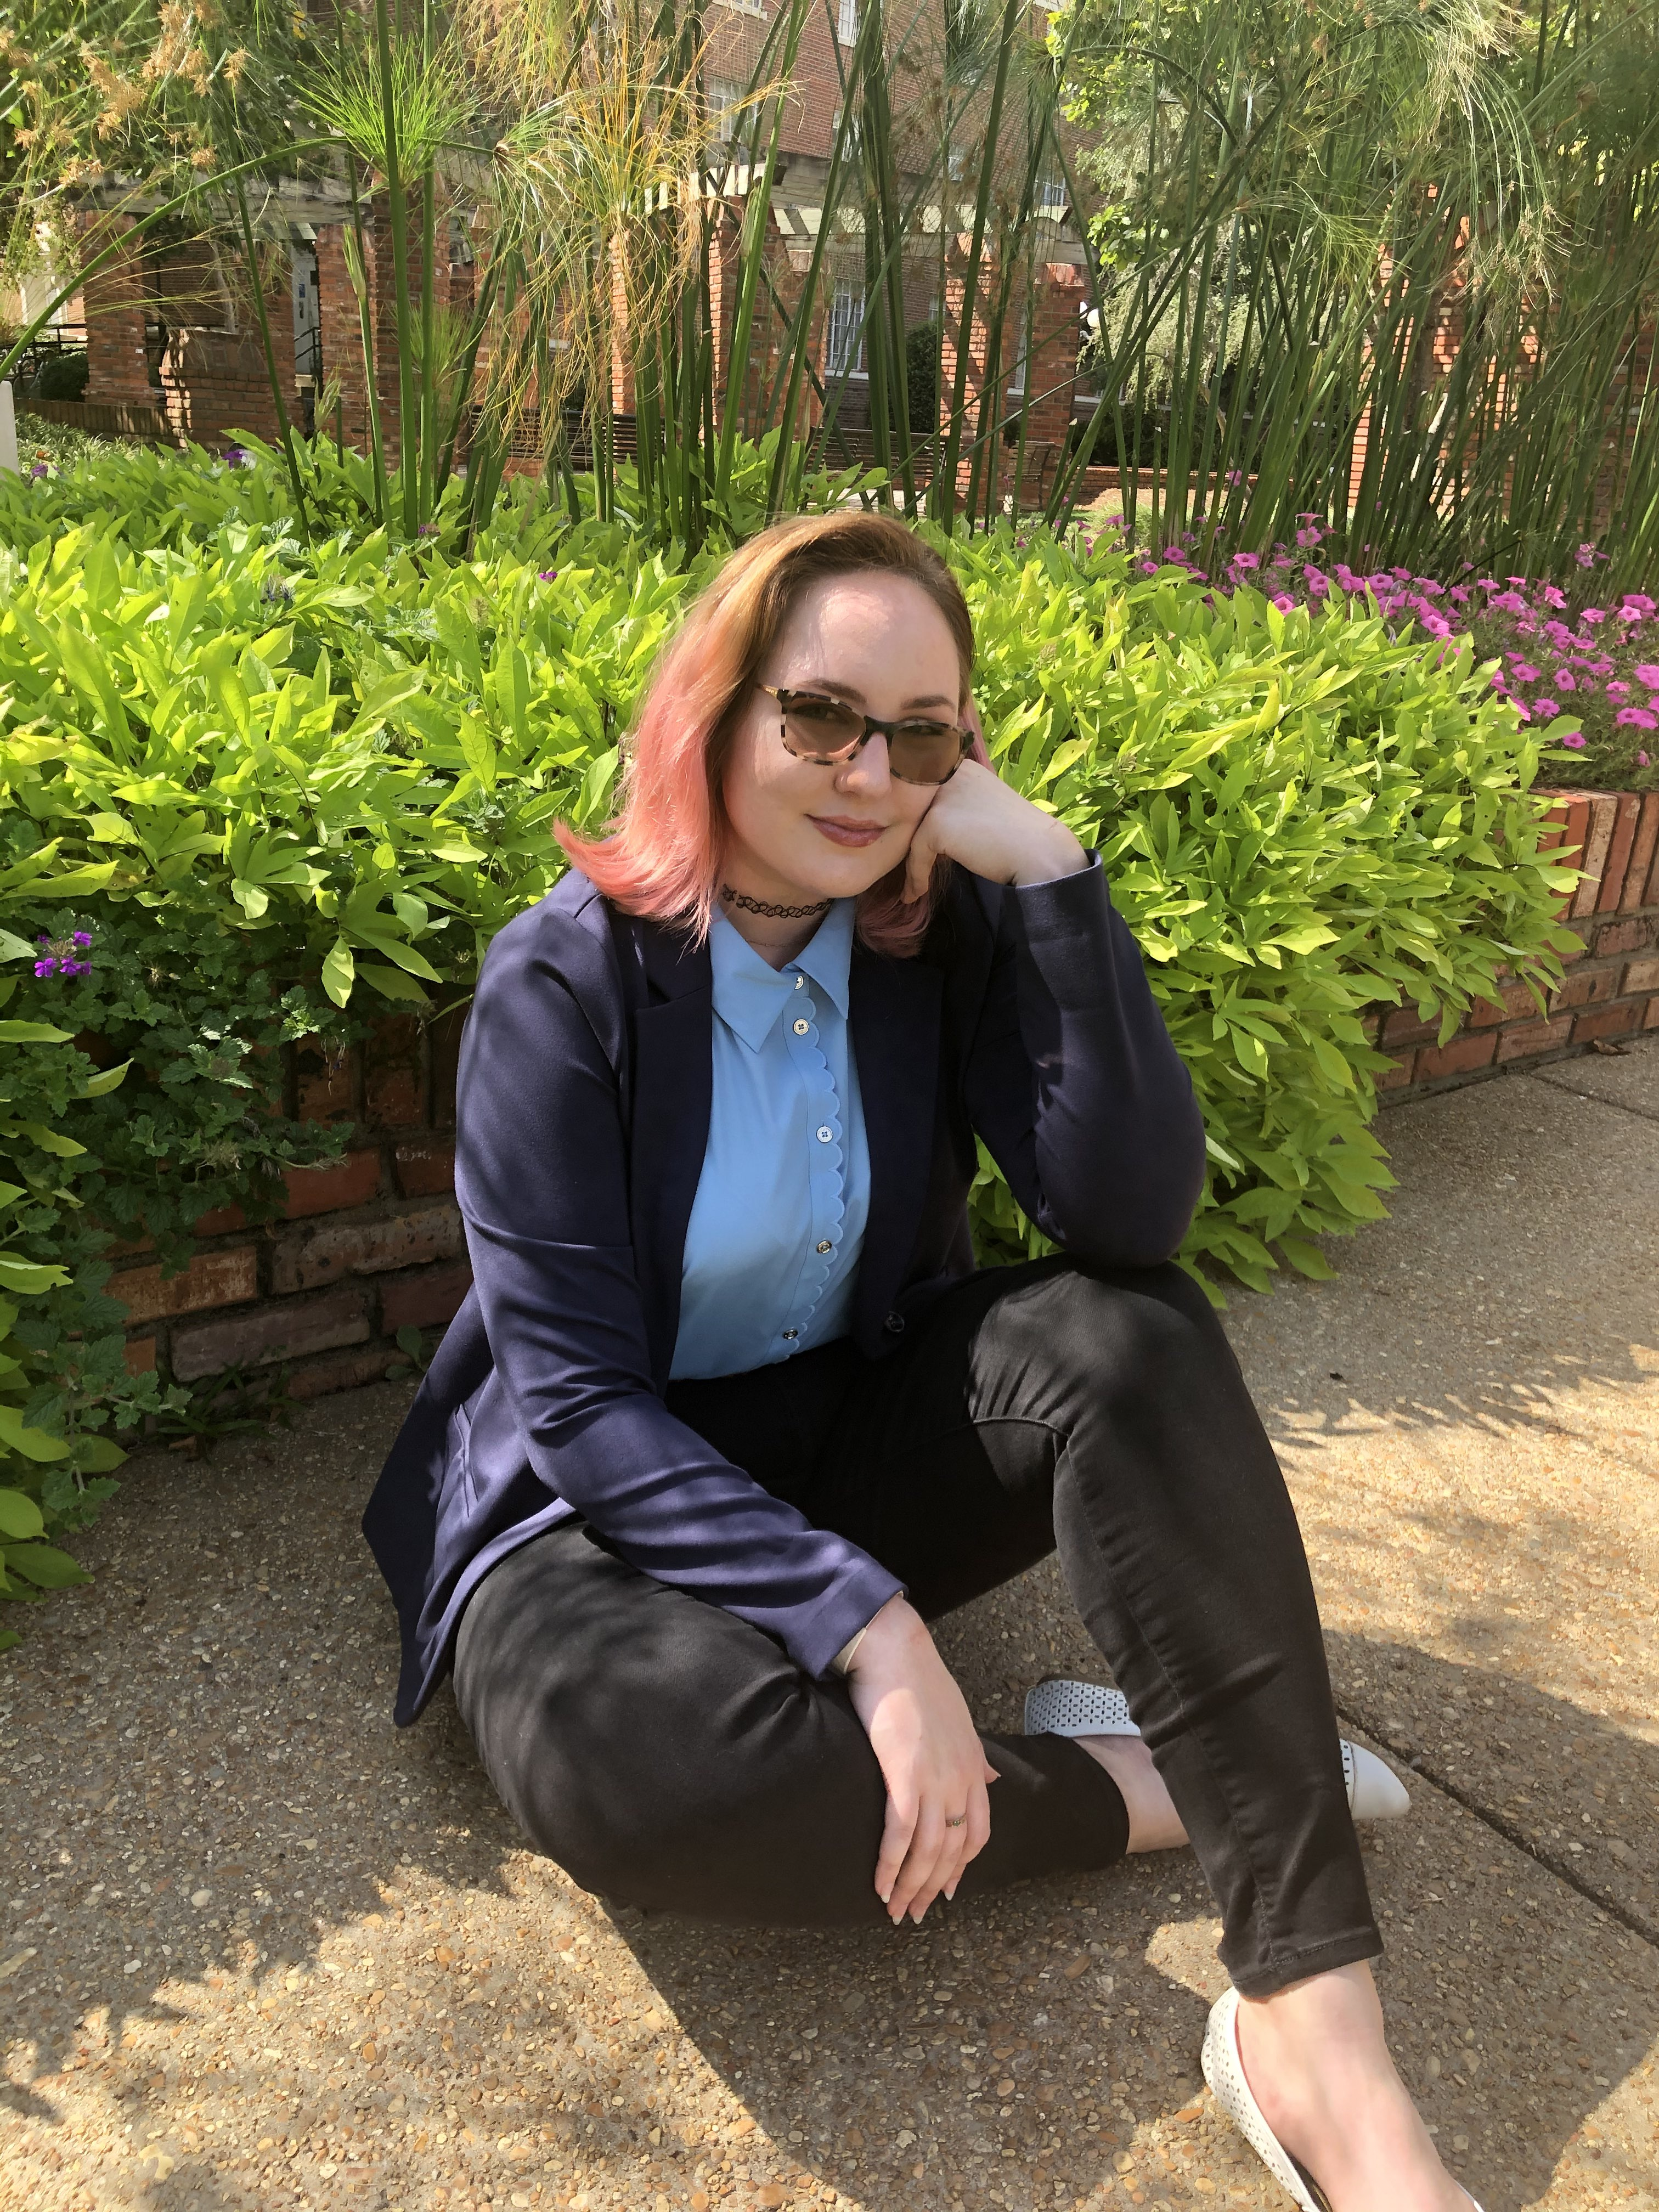
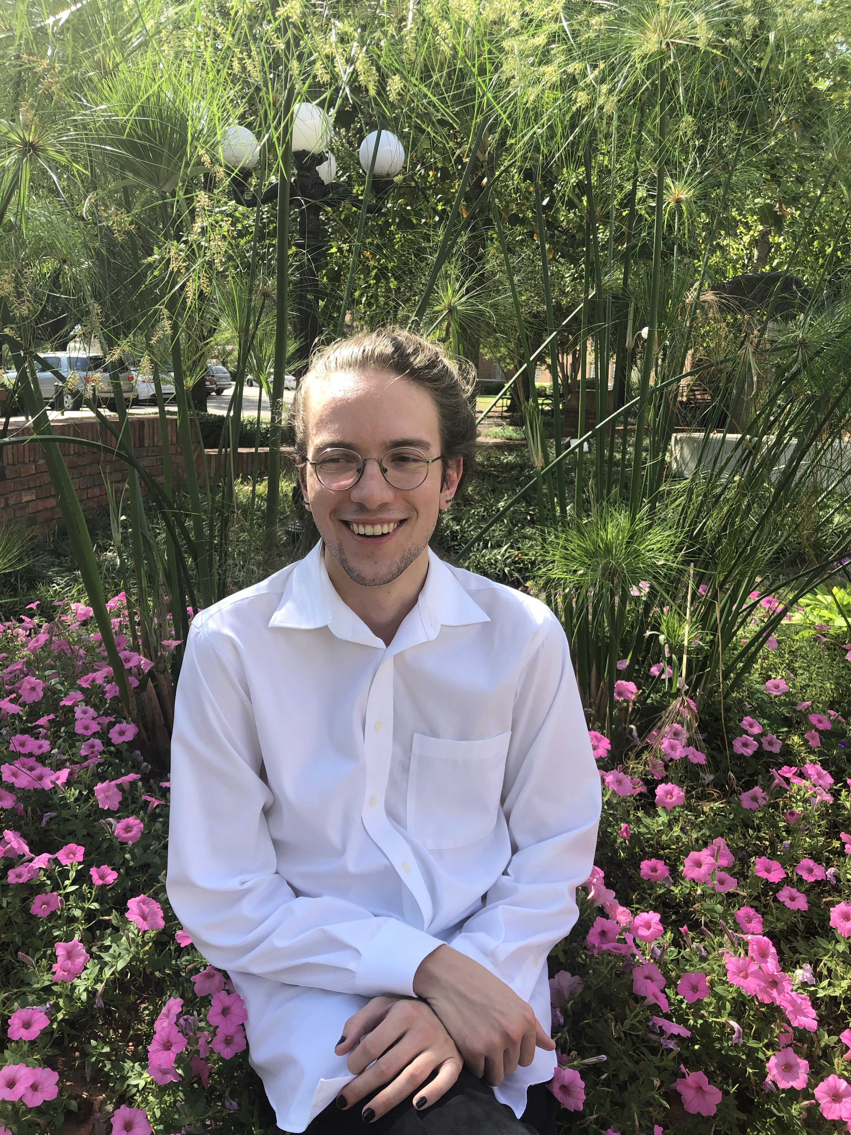
Team Members: Computer Engineers
Carol Pollard
Database
Subsystem
Garrett Smith
Entry Count
Subsystem

Slide 4
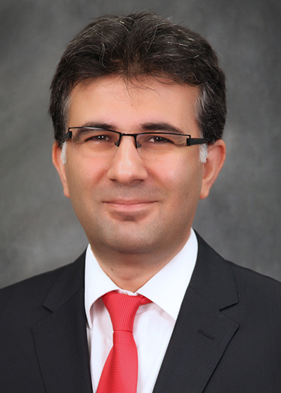
Meet the Advisor
Dr. Mehmet Kurum Ph.D.
Assistant Professor, Mississippi State University
Ph.D. - Electrical and Computer Engineering,
George Washington University, 2009
RF Sensors and Systems
Signals of Opportunity
Machine Learning

Slide 5
Outline
1] Problem and Solution
2] Design Constraints
3] Approach: Hardware
4] Approach: Software
5] Conclusions

Slide 6
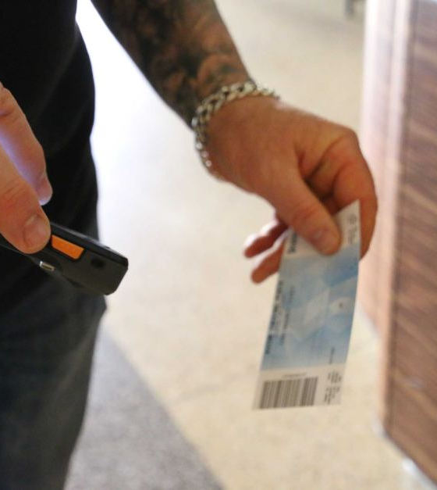
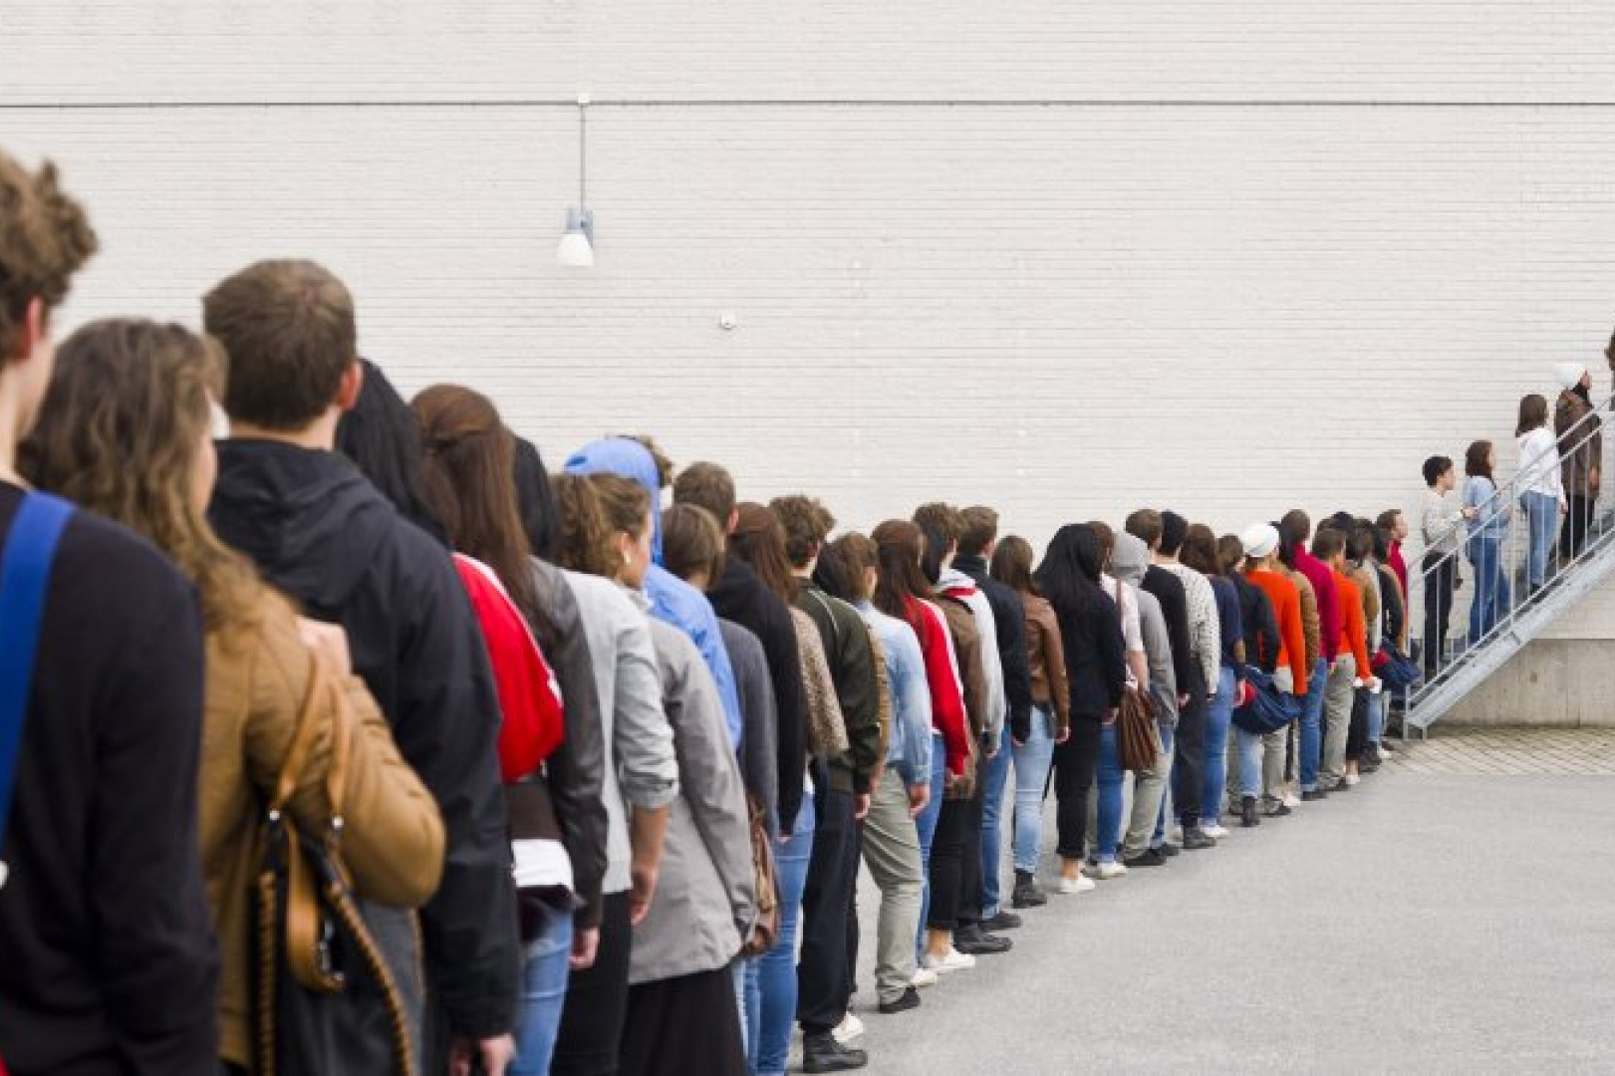
Problem
[1]
[2]
Notes:
Waiting in line is commonplace for everybody: what if it could be quicker?
Currently, two main basis --> One ticket at a time and stop until pass

Slide 7
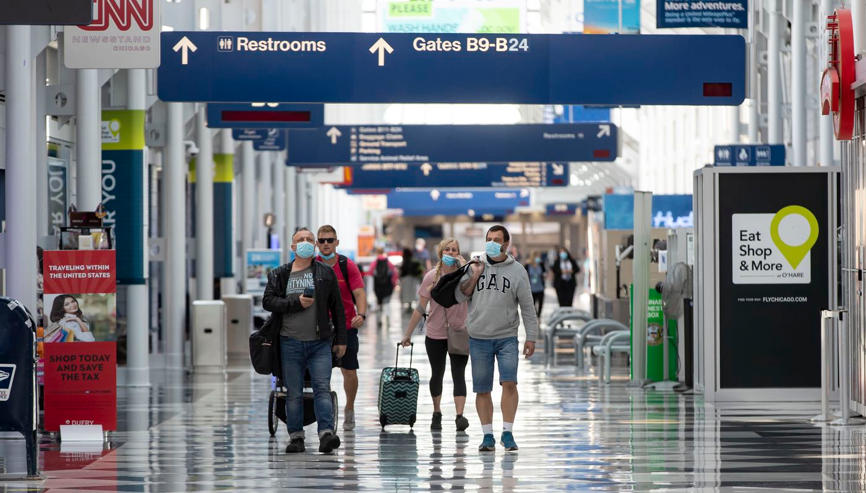
Solution
Multiple people at a time
Contactless
Passive, reusable tags
Reduced cost on personnel
[3]

Slide 8
Design Constraints

Slide 9
Technical Constraints
Name | Description
Read Count | The system identifies up to two tags at once.
Range | The reader operates within a 2-meter range of tags.
Response Time | The system signals errors within 2 seconds of attempting to read a tag.
Security | The system determines the number of individuals approaching the reader, up to four people.
Error Signaling | The system alerts both the tag holders and nearby personnel of errors during ticket validation.
Notes:
Give why's:
Read Count – multiple people but don’t want to make sacrifices in security and reliability
Range – mounted overhead reading down, as such needs comparable range as height.
Response time – given average walk speed, this gives time and room for human intervention if an error is raised
Security – As will be discussed later, a pivotal part of the system is ensuring the number of tickets matches number of individuals
Error Signaling - in order to preserve the continuous queue flow, security needs to be notified so a manual check can be performed to the side

Slide 10
Practical Constraints
Type | Name | Description
Economic | Price Point | The retail value of the system is under $3000.
Safety | Tracking | The system utilizes reusable RFID tags that work to track locations of patrons.
Manufacturability | Installation | The detection components of the system are readily mountable to most surfaces via the use of common hardware.
Health | Health | Passive reading limits contact between parties.
Environmental | Location | The system is suitable for indoor and non-severe outdoor conditions.

Slide 11
Engineering Standards
Specific Standard | Standard Document | Specification / Application
FCC Title 47 Chapter 1 Part 15 | FCC Title 47 Telecommunication | The system operates in the proper RFID frequency range and radiates acceptable power levels.
IEC 60529 | Degrees of Protection Provided by Enclosures (IP Code) | The system is compliant with Ingress Protection 56 (IP56) testing requirements to prevent intrusion of water and dust.
ADA | Americans with Disabilities Act III Regulations | The system is compliant with ADA standards for wheelchair and visually impaired clearances.

Slide 12
Approach: Hardware

Slide 13
Signal Type
•4 major options:
Radio Frequency Identification (RFID)
Bluetooth
Near Field Communication (NFC)
Ultra-wide Band (UWB)
Technology | Requirements | UHF RFID | Bluetooth | NFC | UWB
2 Meter Range | Yes | Yes | Yes | No | Yes
Active/Passive | Passive | Passive, Active | Active | Passive | Active
Tag Handling | Multiple | Multiple | Multiple | Single | Multiple

Slide 14
Reader
Model | Requirements | Fonkan FM-503 [10] | Sparkfun M6E Nano [11] | LPSECURITY UHF-105 [12]
Price | < $300 | $85 | $225 | $92
Max Range | ≥ 2 m | 4 m | 4.9 m | 7 m
RF Output Power | < 30 dBm | 0-25 dBm | 0-27 dBm | 0-30 dBm
Antenna | N/A | Yes | Yes | Yes
Gain/Polarization | Circular | 5.5 dBi, Circular | Not specified | 8 dBi, circular
Range with Antenna | ≥ 2 m | 3 m | 0.6 m | 5 m

Slide 15
Entry Counting
Wide-angle lens to maximize view range
Essential, because the camera will be ceiling-mounted
High FPS for accurate motion tracking
Compatibility with project's hardware
Reasonable price
Model | MLX90640 Thermal Camera Breakout with PIM366 | MLX90640 Thermal Camera Breakout with PIM365 | FLIR ONE Pro | Requirements
Price | $60.84 | $60.84 | $399.00 (Provided by MSU) | <$100
Lens Angle | 110°x75° | 55°x75° | 55°x45° | >70° in width
Thermal Resolution | 32x24 | 32x24 | 160x120 | >20x20
Frame Rate | 64 FPS | 64 FPS | 8.7 FPS | >30 FPS
GPIO | Yes | Yes | No | Yes
Compatible with RPi | Yes | Yes | No | Yes

Slide 16
The Brains
Raspberry Pi 4 B
RAM and CPU clock speed needs
Ethernet and RFID reader connectivity
Multiple displays – touchscreen & monitor
Microcontroller | Arduino Uno | BeagleBone Black | Raspberry Pi 4 B
Processor | 16 MHz, 8-bit | 1 GHz, 32-bit | 1.5 GHz, 64-bit
RAM | 2 KB, 32 KB flash | 512 MB, 4 GB flash | 4 GB
GPIO Headers | 14 pins | 2x 46 pins | 40 pins
Ethernet | No | Yes | Yes
Display | No | HDMI | 2x Micro HDMI, Camera and Display

Slide 17
Error Signaling
Pass until Fail basis
Calls for human intervention when tickets != people
Raspberry Pi pulses nFET controlling power to LED
Already processed tickets also flag an error
T – Tickets
P – People
Inputs | Outputs
T = P = 0 | Pass
T > P | Fail
T < P | Fail
T = P | Pass

Slide 18
Approach: Software

Slide 19
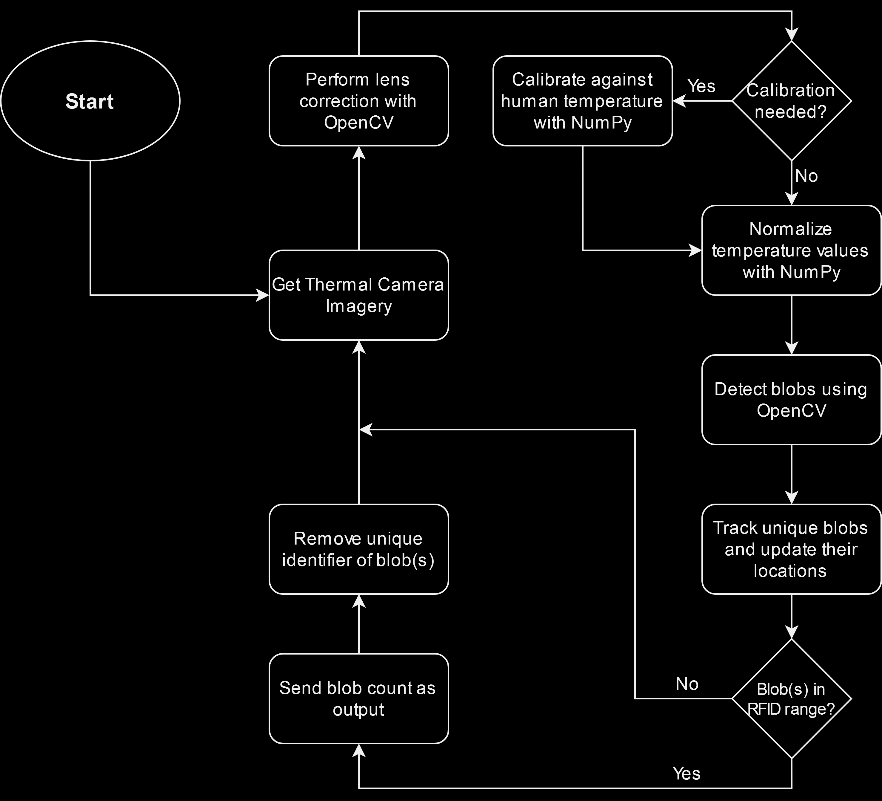
Thermal Imaging
Thermal images have a wealth of data built-in
Temperature
Geometry (position, shape)
People have a predictable temperature and shape
Used to identify "blobs"
Blobs are used to track position, motion, and number of people.

Slide 20
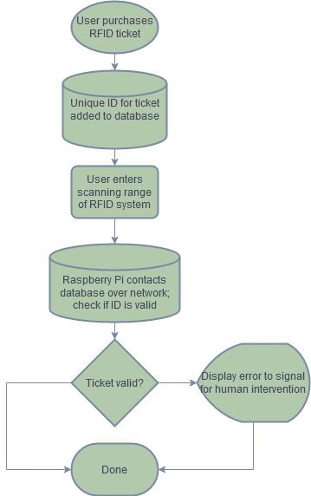
Database
Unique ticket IDs stored in a database
MariaDB
Database hosted on separate computer
Raspberry Pi contacts database when ticket is scanned
Check to see if ID of ticket matches an entry in the database
Network connectivity allows multiple scanners to interface with a single database

Slide 21
Timeline
August
September
October
November
Project Approval, Design Start
Parts Received,
Subsystem Testing
Design Complete,
Parts Ordered
Subsystem
Demonstration

Slide 22
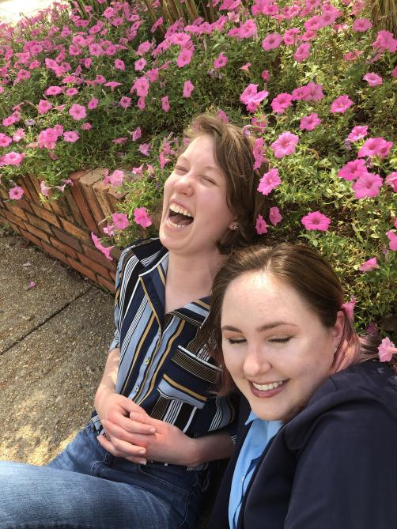
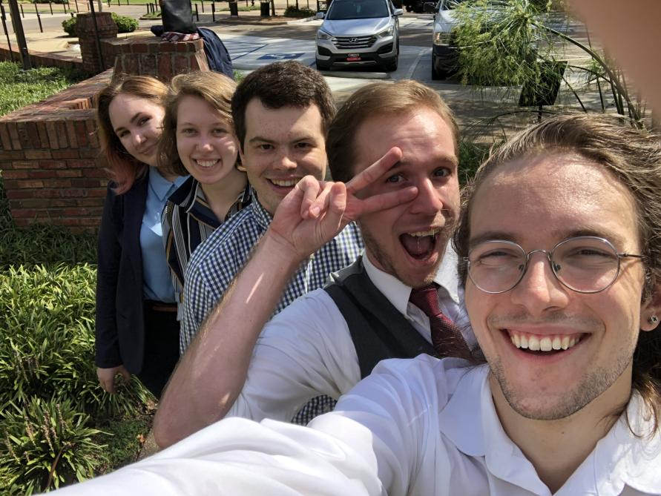
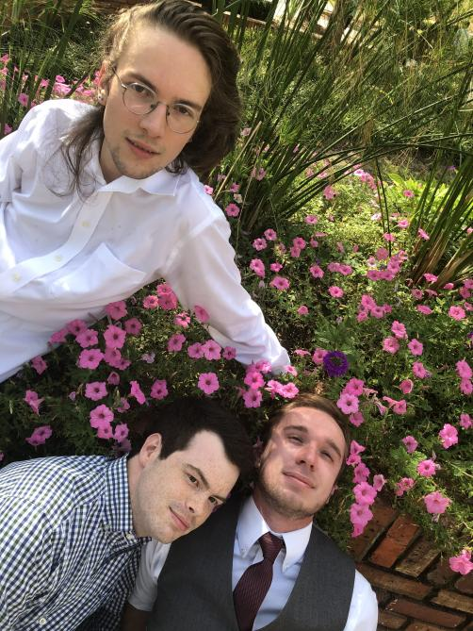
Conclusions
Notes:
New approach to old situation

Slide 23
References

Slide 24
[1] J. Warriner, "A ticket being scanned at Astor Theater." Abc.net.au, Sept. 10, 2019. [Online]. Available: https://www.abc.net.au/news/2019-09-11/astor-theatre-ticket-1/11501204?nw=0 [Accessed Sept. 30, 2020].
[2] J. Krasny, "The Incredible Allure of Long Lines." Inc.com, Jan. 30, 2015. [Online]. Available: https://www.inc.com/jill-krasny/why-waiting-in-lines-makes-things-more-appealing.html [Accessed Sept. 30, 2020].
[3] L. Zumbach, "Coronavirus air travel: Masks, a new boarding routine and bagged snacks. Here’s what you need to know." ChicagoTribune.com, Jun. 19, 2020. [Online]. Available: https://www.chicagotribune.com/coronavirus/ct-coronavirus-ohare-flying-experience-20200619-h3l5gusamfga7ob3psgnc2povm-story.html [Accessed Sept. 30, 2020].

